Slide 1

IBM AICTE Project Interview Trainer Agent
Presented By:
Anaswara Sajimon
College Of Engineering, Cherthala
Computer Science Department

Slide 2
OUTLINE
Problem Statement
Technology used
Wow factor
End users
Result
Conclusion
Git-hub Link
Future scope
IBM Certifications

Slide 3
Problem Statement
Preparing for job interviews can be overwhelming due to the variety of roles, expectations, and formats involved. Candidates often struggle to find tailored resources that match their job profile, experience level, and industry standards. This lack of personalized guidance can reduce confidence and lead to lower success rates during interviews.
PROPOSED SOLUTION:
An AI-powered Interview Trainer Agent, enhanced with Retrieval-Augmented Generation (RAG), that prepares users for job interviews by generating role-specific questions, providing model answers, and offering improvement strategies. The agent should support both technical and soft skills, adapt to user inputs like job title or resume, and deliver a comprehensive, personalized interview preparation experience.

Slide 4
TECHNOLOGY USED
IBM Cloud Lite Services
IBM watsonx.ai
Prompt Lab (Agent Builder)
Retrieval-Augmented Generation (RAG)
Natural Language Processing (NLP)
IBM Granite Foundation Models

Slide 5
IBM CLOUD SERVICE USED
IBM Cloud Watsonx AI Studio
IBM Cloud Watsonx AI runtime
IBM Cloud Agent Lab
IBM Granite foundation model

Slide 6
WOW FACTOR
Hyper-Personalized Interview Prep
Generates role-specific questions and model answers based on resume/job title.
Powered by Retrieval-Augmented Generation (RAG)
Combines live retrieval from real-world sources with LLM intelligence for accuracy and relevance.
Real-Time Access to Industry Trends
Fetches up-to-date HR guidelines, company expectations, and interview formats.
Technical + Soft Skills Assessment
Balances coding/tech questions with behavioral and communication-based queries.
Interactive Mock Interview Simulation
Simulates actual interviews with feedback and improvement tips.
Natural Language Understanding
Leverages NLP to provide human-like interactions and context-aware suggestions.
Confidence-Boosting Feedback Loop
Encourages learning through adaptive tips and personalized progress tracking.
Easy Resume Upload and Parsing
Extracts key details instantly to tailor preparation strategy.
Suitable for Everyone – From Freshers to Professionals
Adaptable design supports various user levels and industries.

Slide 7
About END USERS
The Interview Trainer Agent is designed to assist:
Job Seekers preparing for interviews across technical and non-technical roles
Fresh Graduates aiming to boost confidence and develop soft skills
Experienced Professionals switching careers or advancing in their current path
Students participating in placement drives or internships
Career Coaches / Trainers who wish to simulate interview environments
Recruiters / HR Professionals to test and refine candidate readiness
The agent offers personalized guidance based on the user’s resume, job title, and experience level — ensuring a tailored and effective interview preparation experience.

Slide 8
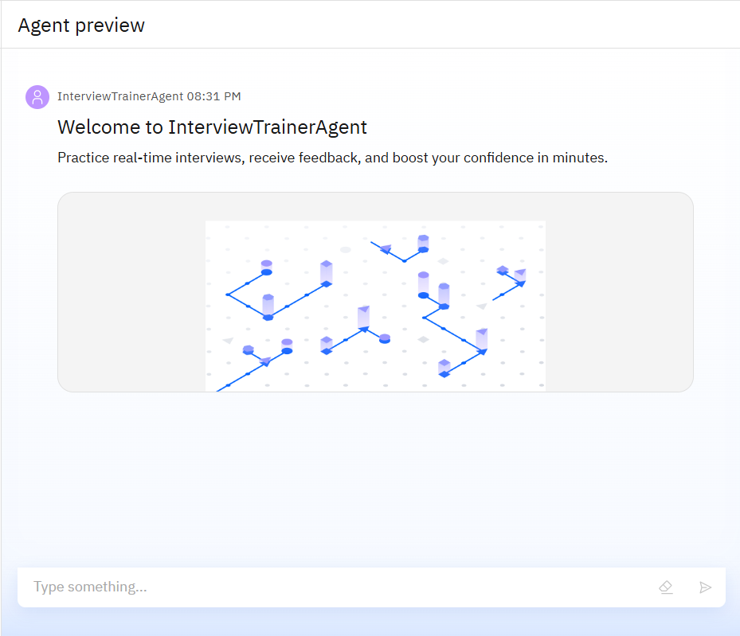
RESULTS
Real-time Interview Simulation: The agent successfully conducted domain-specific mock interviews based on user roles
Dynamic and Contextual Responses: It generated tailored questions from user inputs including resumes and custom prompts.
Progressive Difficulty Handling: Provided increasing levels of challenge in
Feedback & Self-Assessment: Encouraged user reflection with feedback-ready prompts after responses for self-improvement.

Slide 9
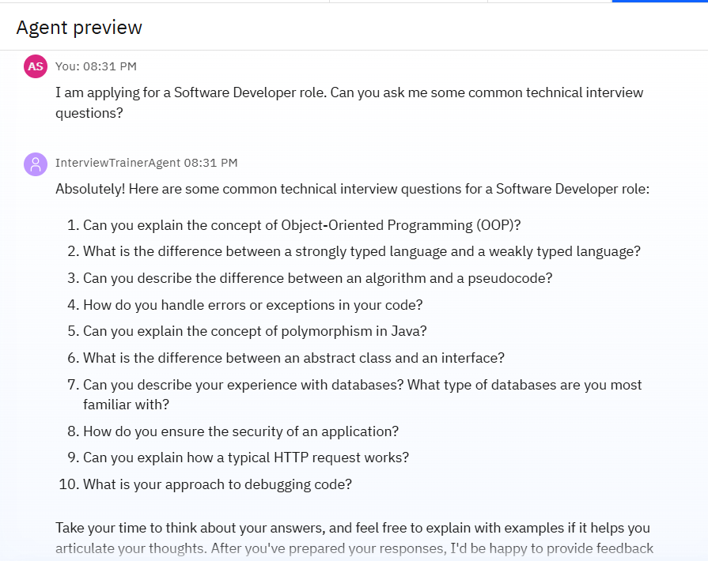
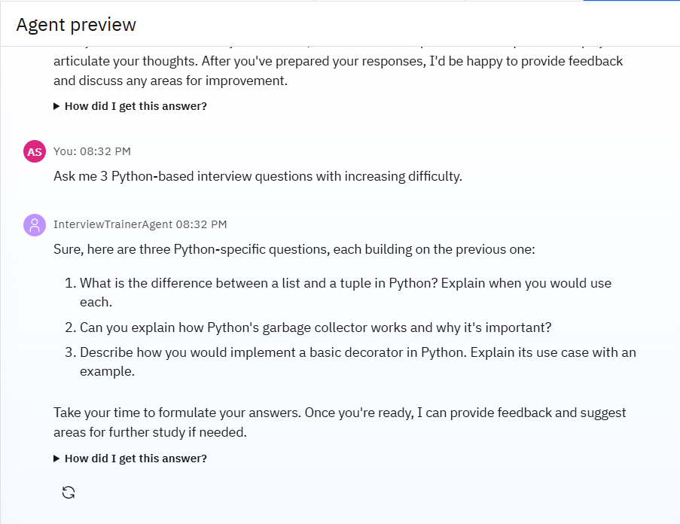

Slide 10
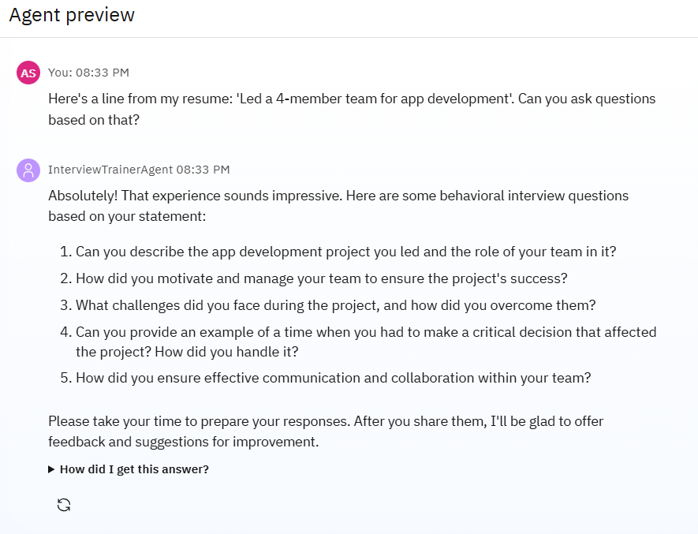
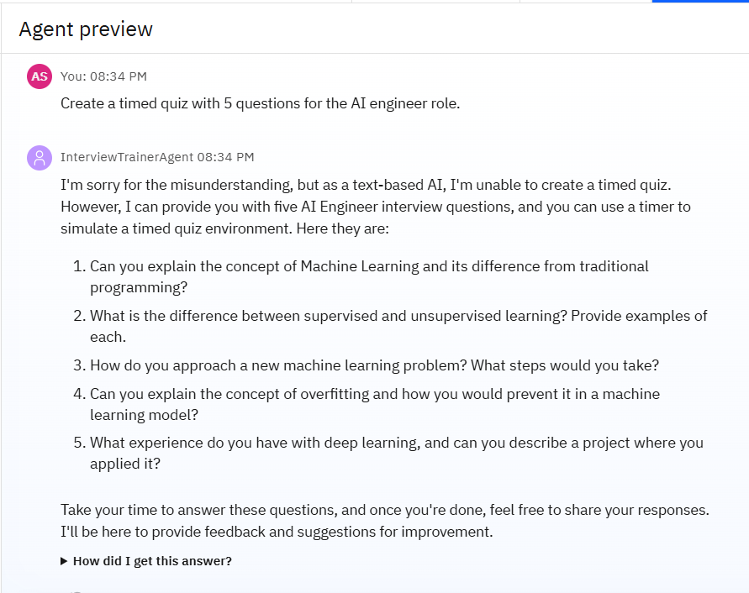

Slide 11
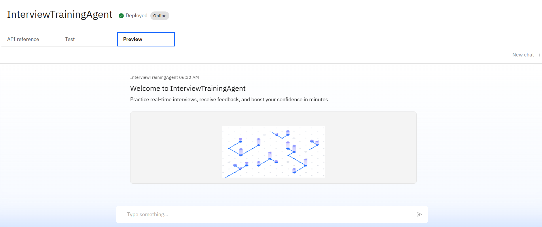
Deployed Agent

Slide 12
CONCLUSION
Personalized Interview Practice: The agent provides customized, role-specific mock interview sessions, helping users prepare effectively for various job roles.
AI-Powered Feedback: Using IBM’s Foundation Models, it evaluates answers and gives constructive feedback, enhancing confidence and communication skills.
Realistic Experience: It simulates real interview scenarios, making users comfortable with professional questioning styles and time-bound answers.
On-Demand Access: Being available as a digital agent, users can practice anytime, making it a flexible and accessible solution for interview readiness.

Slide 13
FUTURE SCOPE
Multilingual Interview Support Enable the agent to conduct and evaluate interviews in multiple languages.
Voice & Video Interview Capabilities Allow users to practice with spoken answers and get feedback on tone, pace, and expressions.
Emotion & Sentiment Analysis Analyze user emotions to build confidence and reduce interview anxiety.
Resume & Profile Integration Tailor questions based on the user’s uploaded resume and job profile.
Integration with Job Portals Connect with platforms like LinkedIn or Naukri for live job-based mock interviews.
Advanced Analytics Dashboard Track progress, highlight weaknesses, and offer personalized improvement plans.

Slide 14
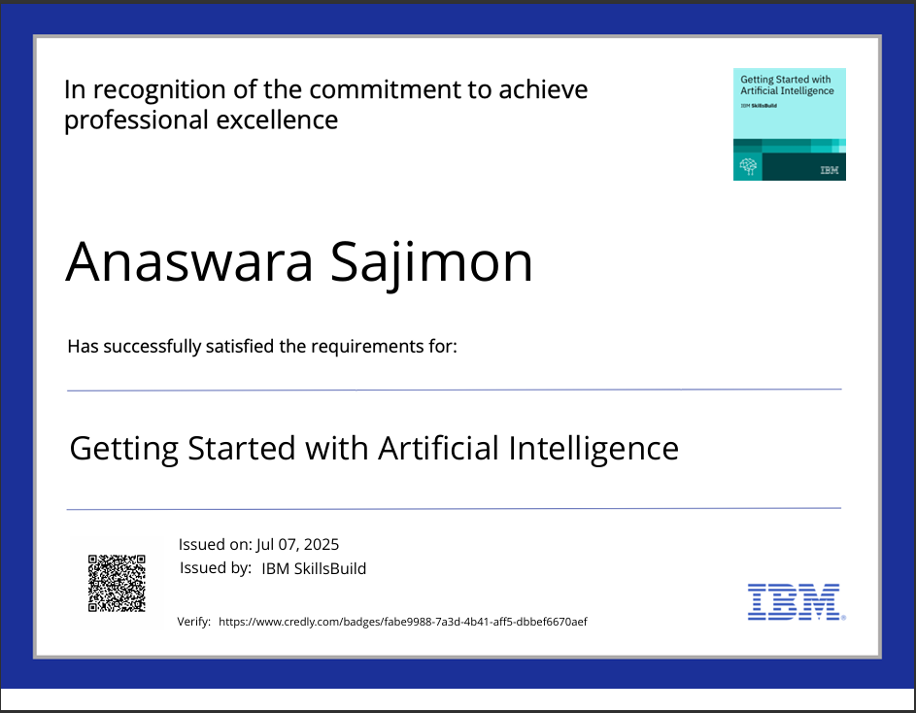
IBM CERTIFICATIONS

Slide 15
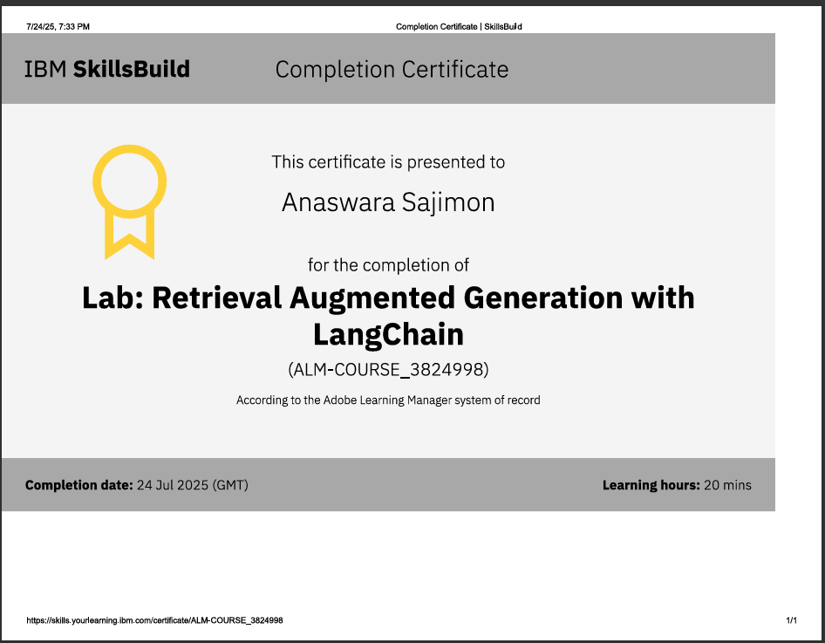

Slide 16
GITHUB LINK
https://github.com/Anaswara-07/InterviewTrainerAgent

Slide 17
THANKYOU

